Slide 1
Program Design
DATA FILES

Slide 2
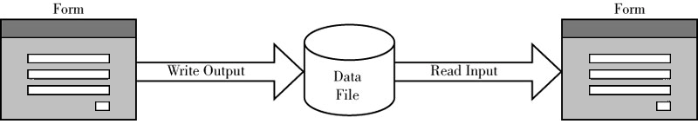
Files Overview
Data can be stored and retrieved using files
A user enters data and the program stores the data to disk in a file
writing or output
A program retrieves the data from the file
reading or input
Slide 3

Slide 3
Files - Simple File I/O
Use text-based files
The commands to open a file
For reading or for writing
The commands to close a file
Once you are finished with it
The commands to read lines of text from a file
The commands to write lines of text to a file
Slide 4

Slide 4
Files - Simple File I/O
You name a file and open it
The opened file is associated with a file variable
This records:
How you opened the file
e.g. opened for writing: stop others from also opening the file for writing
Where you are up to with reading the file
Slide 5

Slide 5
The open() function
To open an existing file data.txt
input_file = open("data.txt", "r")
OR
filename = input("Enter name of input file: ")
input_file = open(filename, "r")
filename is a String: the name of the file
input_file is the file variable, storing “how” you are using the file
“r” to read from a file, “w” to create/overwrite & write to a file, “a” to append to a file
Slide 8

Slide 6
The close() function
Input_file.close()
To close a file, perform the close() function on the file variable of an opened file
This relinquishes your use of the file
And lets others access the file
Slide 9

Slide 7
Reading Lines from the file
Once you have a file variable of a file open for reading, use a loop to read each line from the file:
for line in input_file:
<block of code to process the line>

Slide 8
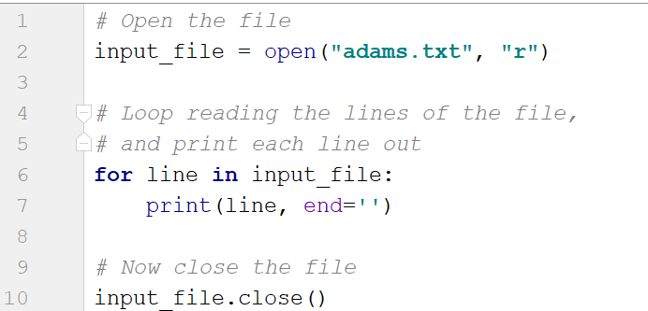
Display the contents of a text file
Note: each line ends with a \n newline
print() always appends a newline
We have to tell print() to not append the \n

Slide 9
Writing Lines to a text file
Once you have a file variable of a file open for writing, use the write() function on the file variable:
output_file.write("Hello there\n")
Notes:
The parameter must be a String
write() doesn’t append a newline, you need to do that yourself!

Slide 10
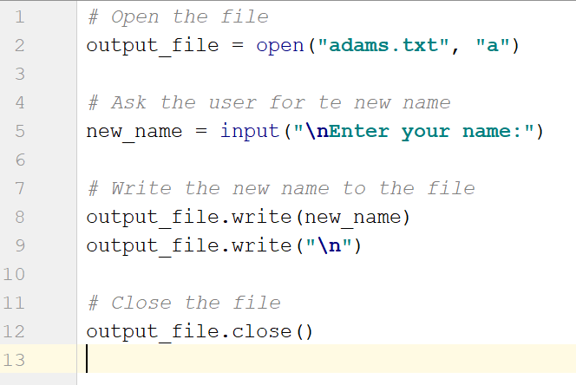
Writing Lines to a text file
Note: You can combine the write() as one line
output_file.write(new_name + "\n")

Slide 11
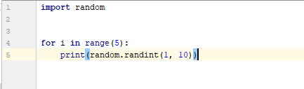
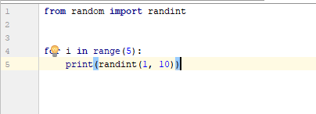
Using Import in Python
Import used to access other useful functions in Python
Use the import keyword:
import <module name>
Examples:
Or use the following to avoid the dot notation:

Slide 12
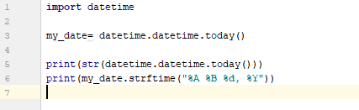
Using Import in Python
Another example - Get the current date
strftime() is used to format the date string (e.g. %A returns the full month)
Formatting of date
https://www.w3schools.com/python/python_datetime.asp

